Slide 1
BPMN Strategic Process Models
David Wyatt

Slide 2
Session Plan
Strategic Process Model
Strategic vs Operational Planning
Strategic Process – Purpose and Benefits
Strategic model aims
Model Requirements
Strategic Process – Procedure
Strategic Process Model – Lifecycle
In Strategic Process Model
  Happy Path
  Gateways
  Events and Event Based Gateways
Conversation
Choreography

Slide 3
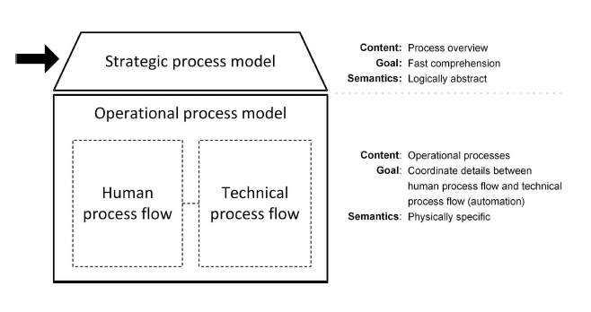
Strategic Process Model

Slide 4
Strategic vs Operational Planning
Strategic Planning
  Is concentrated towards attaining the long-term objectives of business.
Operational planning
  Is done to achieve short-term objectives of the company.
Operational Goals
Strategic Goals
Vision And Mission

Slide 5
Real-world comparison: restaurant
Strategic: customer orders → kitchen prepares → order delivered → customer receives meal.
Operational: waiter logs order → POS sends ticket → chef checks ticket → ingredients prepared → etc.
Both views can be useful, but they answer different questions.
Strategic modelling deliberately keeps the picture compact.

Slide 6
A simple definition of “Process”
A process is a sequence of activities that moves from a trigger towards an outcome.
Example:
  food delivery → order received → food prepared → delivery → customer receives meal
A strategic model does not show every tiny action.
It gives a clear, compact picture people can discuss.

Slide 7
Strategic Process – Purpose and Benefits
Depict a process from start to end at the strategic level.
Must be
  Compact
  Readily comprehensible
  Include information on computer systems and/or human task.
MENTI 1 Multiple choice
Which audience is a strategic-model most useful for?
Notes:
Audience, likely to be the
Executive
Top managerial
Process manager
Process owner

Slide 8
Strategic model aims
To clarify what is and is not part of a process.
To identify resources for a process and assign responsibilities.
To identify key performance indicators and specify their characteristics.
An example KPI may be that a process has a maximum run time of 24 hours.
To review a process initially in the course of an improvement action.

Slide 9
Model Requirements
Must be comprehensible
Clear who the customer of the process is
Single sheet of standard-sized office paper
Limit to (Subjective and can vary)
  10 or fewer flow objects
  No more than 8 artifacts
  No compensation events or multiple-instance tasks
Make the syntax as correct as possible, but allow inconsistent semantics if necessary

Slide 10
Strategic Process - Procedure
We model strategic processes
  After the initial process-discovery
  When we have a general idea of an existing process
  At the beginning of process design
  Configuring the new or improved process
Never attempt to model a process in a greenfield approach
  Do not try to account for every contingency and any possible variation

Slide 11
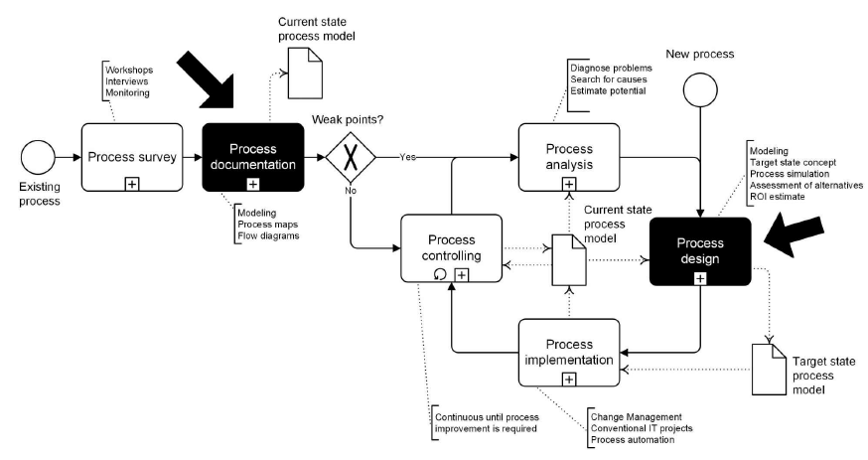
Strategic Process Model - Lifecycle
Notes:
The lifecycle flow is:
You start with an existing process.
You carry out a process survey to understand what is currently happening. The diagram suggests this can involve things like workshops, interviews and monitoring.
You then produce process documentation, such as process maps and flow diagrams.
From that documentation, you ask whether there are weak points in the current process.
If there are weaknesses, you move into process analysis. Here you diagnose problems, look for their causes and estimate the potential for improvement.
From the analysis, you move into process design, where you create the improved or target process. This can involve modelling the target state, simulating the process, assessing alternatives and estimating return on investment.
The new design is then put into practice through process implementation.
Once implemented, the process moves into process controlling, where its performance is monitored.
That monitoring can reveal further problems or opportunities, so the cycle can start again.
The + means collapsed sub-processes; the document with dotted line shows information used by or produced by a task; the black tasks have no intrinsic meaning within BPMN and are being used for emphasis here
This diagram shows how process modelling fits into continuous process improvement: we first understand the existing process, analyse it, redesign it, implement the new process and then monitor it for further improvement.

Slide 12
Case Study
Recruiting Process — from story to strategic BPMN

Slide 13
Case Study : Recruiting Process
When a department wants to fill a vacancy, the manager notifies me by email. We post the job and wait for appropriate applications. We check the applications, select a candidate, and fill the position. Essentially, our job is done if the selected candidate signs an employment contract, even though we have not yet recorded his or her information in the personnel files
MENTI 2 Open text
What triggers the recruiting process?

Slide 14
Recruiting process - simple strategic view
Start
Post job
Receive applications
Check applications
Select candidate
End

Slide 15
Case Study : Recruiting Process
We can now extract the following key data
  The process is triggered by a department’s requirement to fill a vacancy.
  A job is posted, applicants apply, applications are checked, and the vacancy is filled.
  The process has reached its target when the vacancy is filled, in other words, when an employment contract is signed

Slide 16
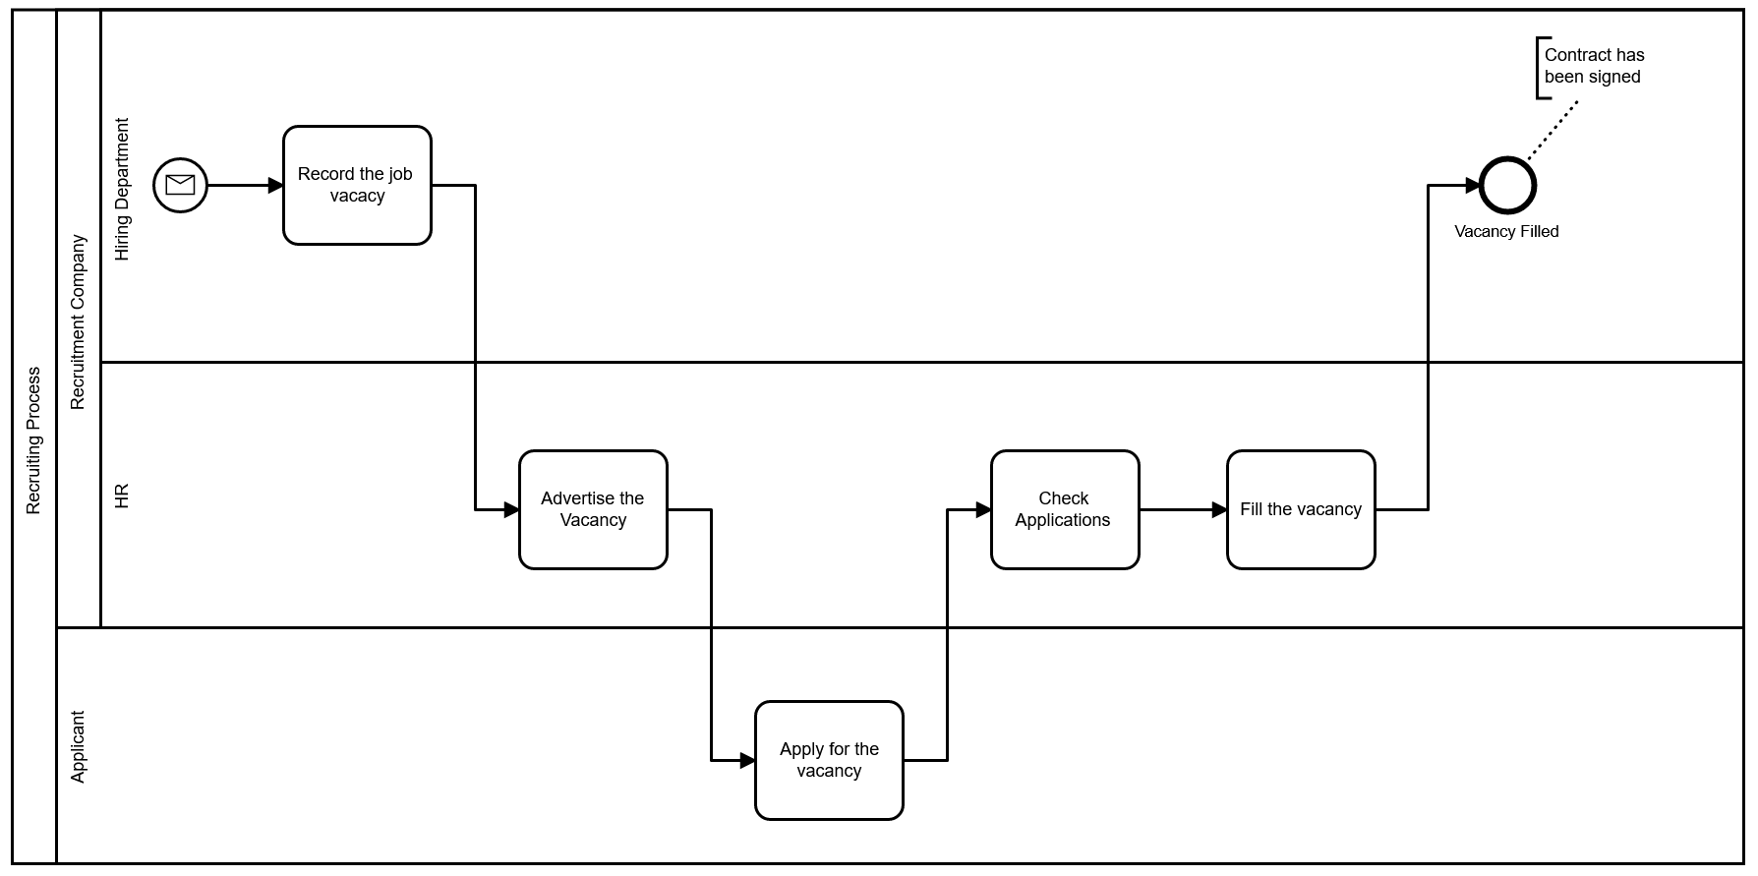
Case Study : Recruiting Process (initial attempt)

Slide 17
Case Study : Recruiting Process
Limitations and shortcomings of previous diagram
  It is not a clear, syntactically correct solution
  The job applications involve the requesting department as well as Human Resources – This is not clearly shown
  The applicants are not orchestrated by a conductor
  How does an applicant learn about the vacancy?
  We are waiting for one application instead of several
We design a Strategic Process
  The above can be omitted
  For strategic process models, we usually abstain from using multiple pools

Slide 18
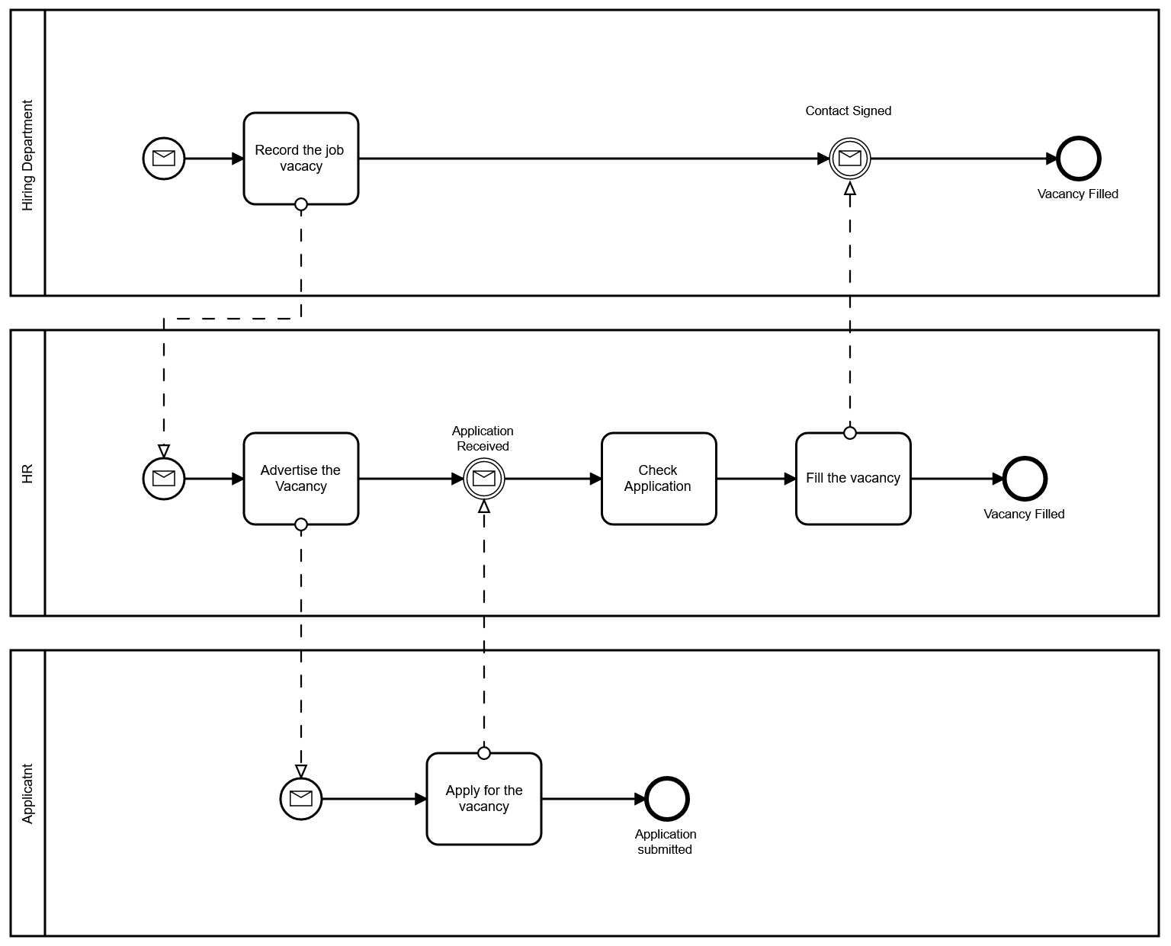
Case Study : Recruiting Process (improved)

Slide 19
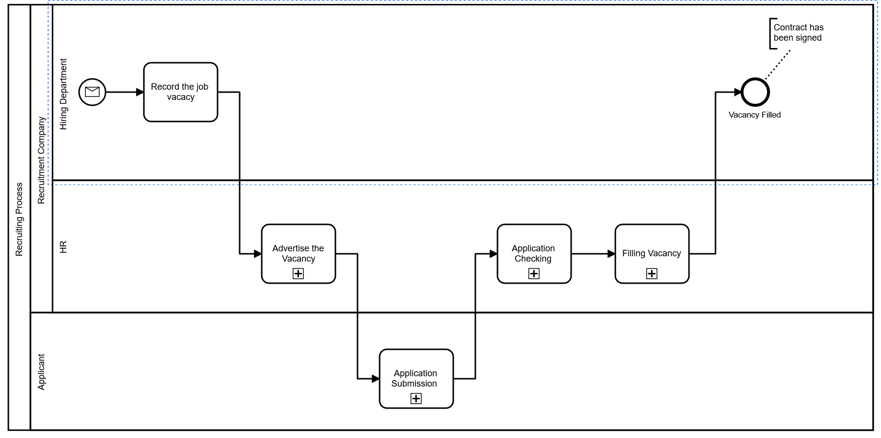
Case study: Recruiting Process (using subprocesses)
Recruiting Process — from story to strategic BPMN

Slide 20
BPMN Building Blocks
Tasks, sub-processes and gateways

Slide 21
Tasks and sub-processes
Task = a unit of work at the level of detail chosen for the model.
Sub-process = a grouped process that can hide internal detail.
At strategic level, use meaningful business activities rather than technical micro-steps.
Example:
  Assess application is strategic;
  open PDF → copy email → paste into spreadsheet is operational detail.

Slide 22
Happy path
At strategic level, we focus on the happy path.
Happy path = the process path and result we would like to see.
Most of the time, the happy path is sufficient.
If a process has genuinely different triggers, multiple paths may be needed.
MENTI 3 Multiple choice
What is the happy path?

Slide 23
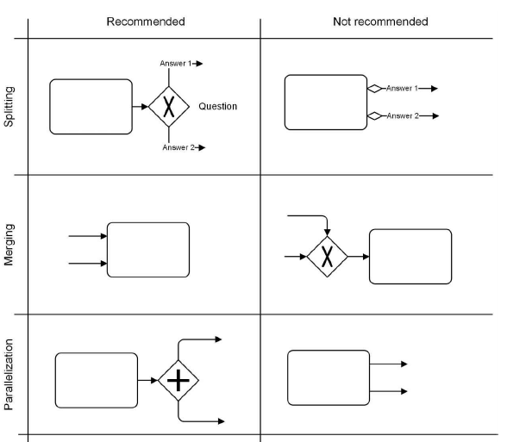
Gateways
If a process has different triggers (e.g. customer-driven process) , we model multiple paths.
  Use XOR gateways for splits
  Merge tasks without XOR merge
  Use the AND gateway with no direct exit
  Do not use the OR gateway
  Do not use the complex gateway

Slide 24
XOR gateway — “one route”
Example: a customer chooses between:
  a Standard OR an Express delivery.
Only one alternative is selected.
Use XOR to show this exclusive choice.
Keep the reason for the choice understandable at the strategic level.

Slide 25
AND gateway — “both are needed”
Example: a travel agency books both a flight AND a hotel.
The two activities can be performed in parallel.
The process continues after the required parallel work is complete.
Do not use AND simply because two tasks exist — use it when parallel logic matters.

Slide 26
Menti: XOR or AND?
Scenario A: customer chooses between Standard and Express delivery.
Scenario B: travel agency books both flight and hotel.
MENTI 4 Multiple choice
Scenario A uses which gateway?
MENTI 5 Multiple choice
Scenario B uses which gateway?

Slide 27
Events & Information
Start/end events, timers, messages, data and artefacts

Slide 28
Events and Event Based Gateways
Using start and end events at the strategic level is recommended
Intermediate events often require a little explanation.
None events may be used as start, intermediate, and end events
Message and timer events are virtually self-explanatory and can be used
The conditional event is problematic because people don’t recognize it right away.
MENTI 6 Multiple choice
Which event communicates a waiting period?

Slide 29
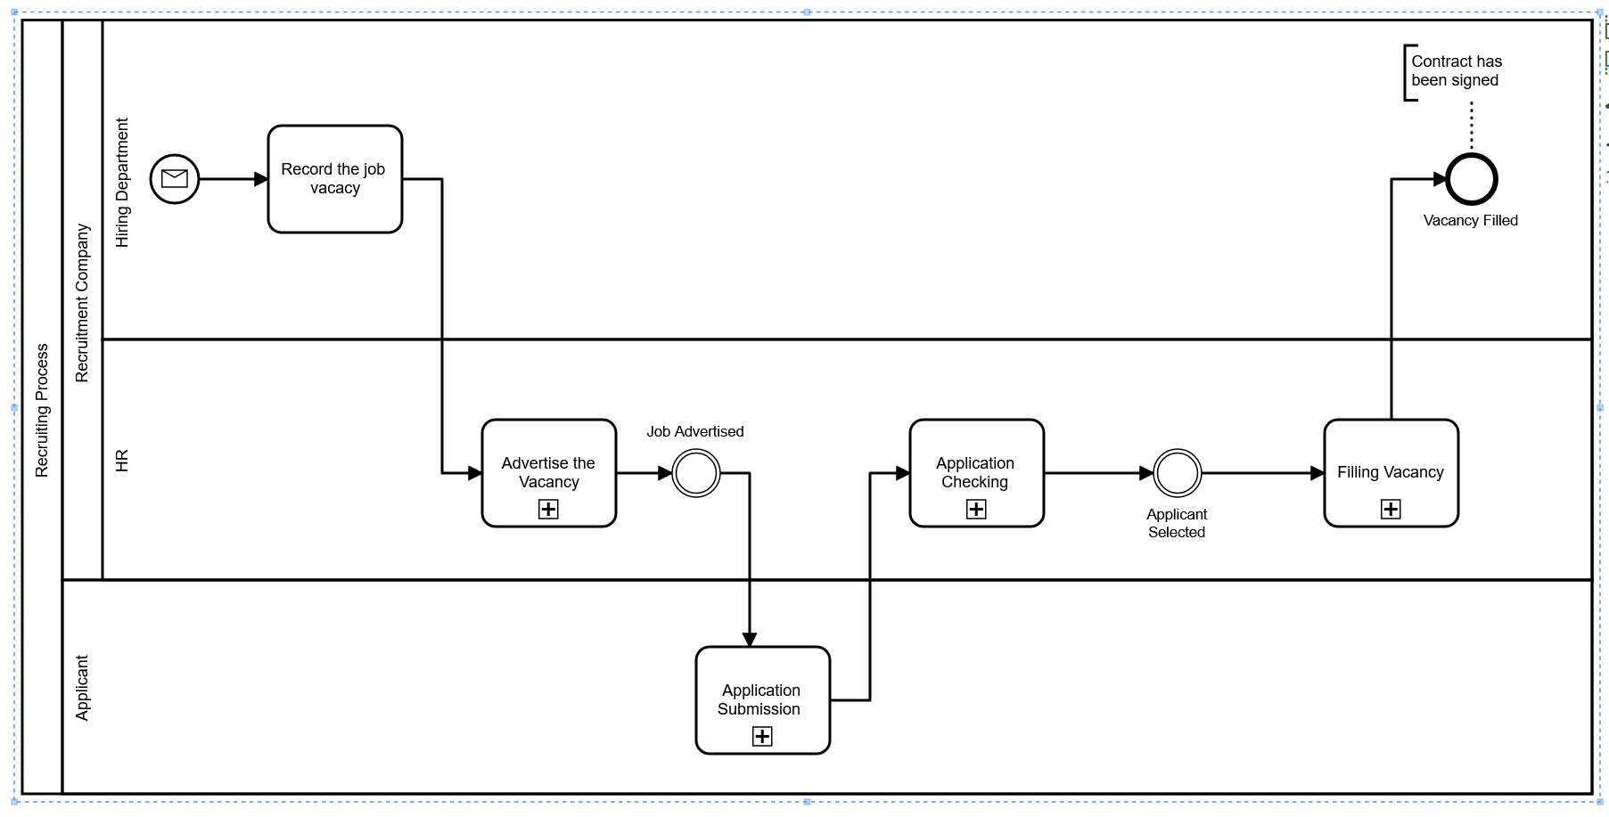
Events and Event Based Gateways

Slide 30
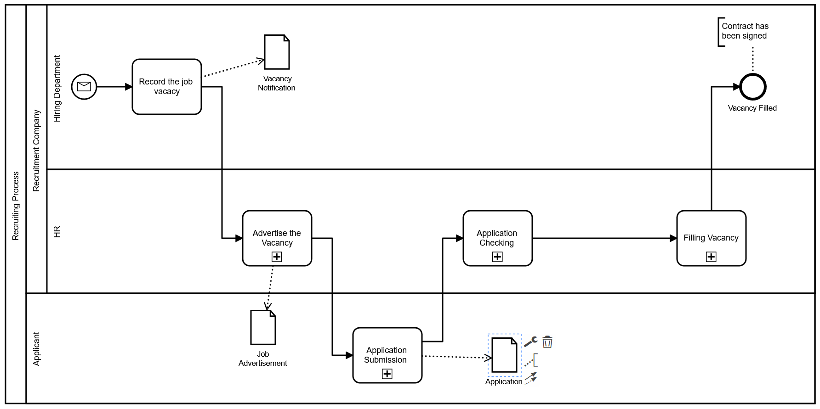
Data and Artefacts

Slide 31
Process Analysis

Slide 32
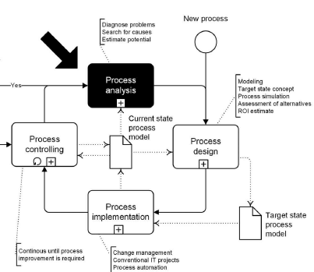
Process analysis on the strategic level
Detailed survey to model the actual state of the process at the operational level.
Detailed survey and documentation can be helpful
  cost to benefit ratio
Documentation at the strategic level

Slide 33
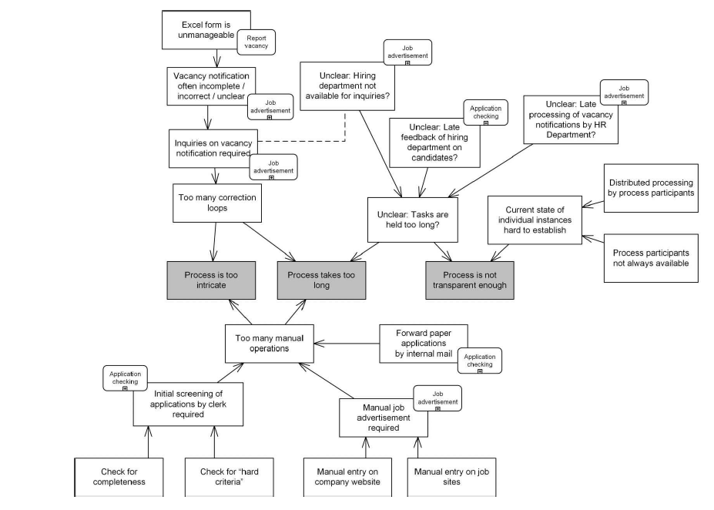
Process analysis
Notes:
We shouldn’t just identify that a process is slow or confusing; analyse why it is slow or confusing.
Process analysis means taking the weaknesses in the current process and tracing them back to their underlying causes, so we know what should be improved.

Slide 34
Communication Views
Conversation and choreography

Slide 35
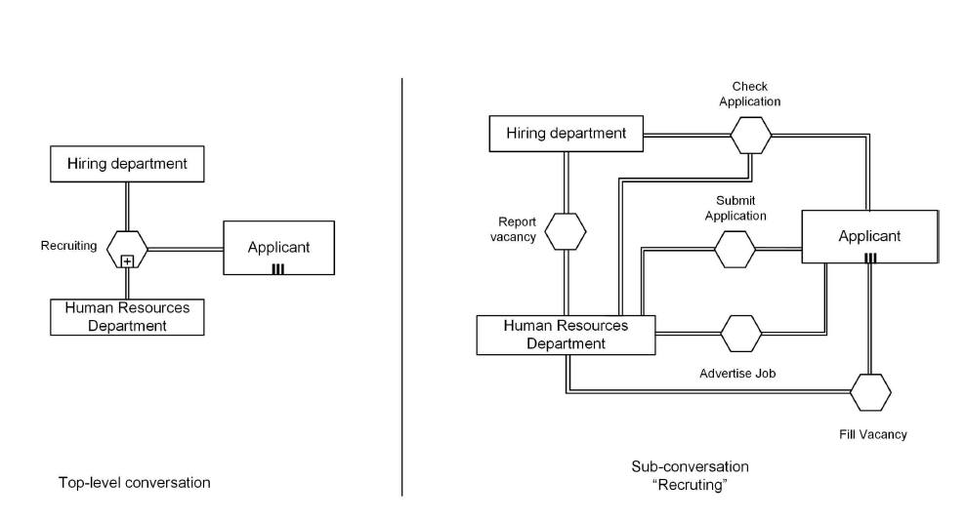
Conversation
Conversation diagram is good for representing all the parties in a single view. It is not required for a strategic process model itself, but it is a useful BPMN view for supporting strategic analysis of interactions between participants.
The hexagonal symbols represent conversations
Notes:
A conversation diagram gives us a communication-centred view of the process. It shows who is involved and the main topics or exchanges between them, without showing all the internal process steps.

Slide 36
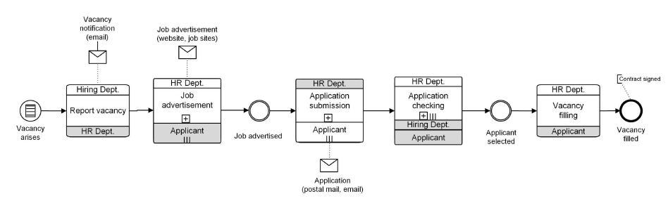
Choreography
Considers the order of communication
It is a mixture of conversation and process diagrams
  A choreography combines the sequential flow of a process with a focus on interactions between participants
Again, this is not a required part of a strategic model but can be useful as a compact interaction-focused view
Notes:
The main symbols are:
Rectangular blocks with participant names above and below — these are choreography (interactions) tasks.
In each task, the participant bands show who is involved.
The white/grey shading of the participant bands indicates which participant is the initiating participant (unshaded), and which is the receiving participant (shaded).
The small + inside some choreography tasks means the interaction is a collapsed choreography subprocess.
The envelope symbols represent messages being exchanged.
The plain double-ring circles between stages are intermediate milestones/events occurring during the choreography.

Slide 37
Summary

Slide 38
Strategic BPMN should:
Show the process from trigger to outcome
Focus on meaningful business activities
Remain compact and understandable
Model primarily the happy path
Use sub-processes to hide unnecessary detail
Use gateways only where the logic matters
Show responsibility, important events and key information
Support analysis and improvement, not document every operational step
The goal is not to model everything – it is to model enough to understand and discuss the process

Slide 39
Choose the right BPMN view
View | Main Question
Strategic process model | What are the major stages from trigger to outcome?
Operational process model | Exactly how is the work carried out?
Conversation diagram | Who communicates with whom, and about what?
Choreography diagram | In what order do participants interact?
Different views answer different questions; use the simplest view that communicates what you need.

Slide 40
Common beginner mistakes
Putting too much technical detail into a strategic model.
Trying to model every exception and contingency.
Using gateways when a simple sequence is enough.
Confusing an activity with a resource/data object.
Forgetting the trigger or target outcome.
Making the diagram too large to explain comfortably.

Slide 41
Short Quiz
MENTI 7 Multiple choice
At strategic level, what is usually simplified?
MENTI 8 Multiple choice
A strategic process model should primarily be…
MENTI 9 Open Text
What should a strategic model leave out?
MENTI 10 Multiple choice
Which view focuses on the order of communication?
MENTI 11 Likert 1-5
How confident are you with strategic BPMN modelling?
MENTI 12 Open Text
In one sentence, what is the most important thing you learned today?

Slide 42
References and Further Reading
BPMN 2.0 by example
https://www.omg.org/cgi-bin/doc?dtc/10-06-02.pdf
Real-life BPMN
https://www.omg.org/oceb-2/documents/real-life-bpmn-CamundaOCEB-2-DownloadSection.pdf
BPMN Specification
https://www.omg.org/spec/BPMN/2.0/About-BPMN/
Green Field Vs Brown Field approach

Slide 43

Any questions?
Thank you for your attention
Dr David Wyatt

